Slide 1
What’s the Time?
Geoff Huston
APNIC

Slide 2
Background
All computers run with some kind of internal oscillator (mistakenly called a ‘clock’)
  This clock manages the internal state changes each cycle of the central processing unit
  Clock ‘ticks’ are fed to a digital counter
  From this counter the computer can maintain a conventional clock and maintain the current time

Slide 3
Why is Time useful?
To stop everything happening at once!

Slide 4
Why is Time useful for a computer?
To understand when things happen
  Crontab and event scheduling to ensure that a computer performs certain tasks at precise times
To understand the relative age of things
  For example, with NFS file systems its vital to understand which file is more recent
To understand when things are valid

Slide 5
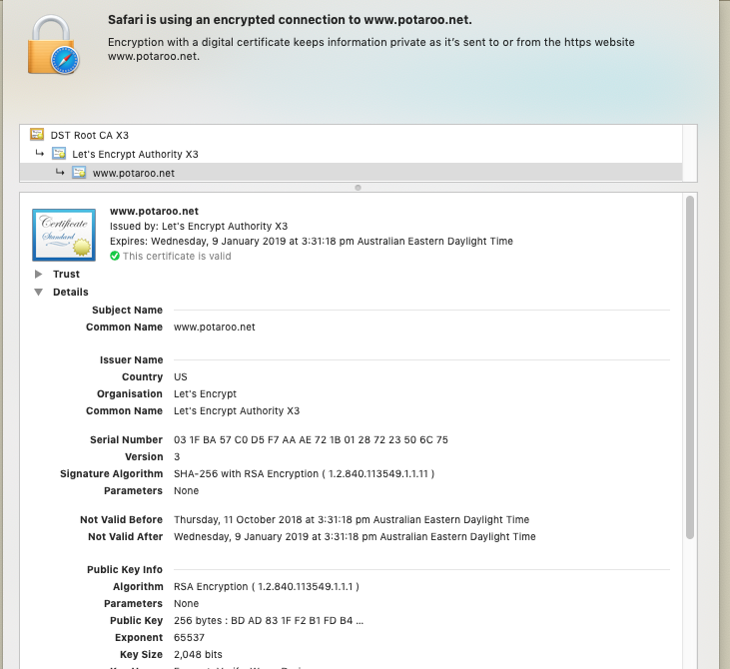
Security Certificates and Time
These security credentials are only usable in a defined window of time
The computer’s local clock is compared to these dates to determine whether to trust this certificate or not

Slide 6
So we need to keep “time”
But this can be challenging
Computer clocks are based on quartz Crystal oscillation
  Quartz crystal oscillation is only stable if the temperature and excitation voltage are kept stable. Changes in temperature or voltage will cause oscillation changes
Computer time of day clocks rely on counting ticks in a register
  Which is performed by software running in the processor at an elevated interrupt level
  If the processor runs for extended times at an even higher interrupt level then clock ticks can be ‘lost’

Slide 7
So we need to keep “time”
We actually want to keep accurate and stable time
  Accurate in that every reference timekeeper keeps the same time
    (modulo the spacetime stretch factors of relativity)
  Stable in that the duration of each measured interval is exactly the same
We need to synchronize the internal computer clock to a reference time

Slide 8
What is reference “time”?
We all know that time is divided into days, where a ‘day’ is defined as the duration between successive events when the sun is at precisely the same elevation in the sky
  But we don’t do this any more because the earth and the sun are poor timekeepers
We turned to distant quasars as the reference point
  But we don’t do this any more because we needed even greater precision
We turned to nuclear physics
  Time is defined using Système International (SI) seconds, defined as the duration of 9,192,631,770 periods of the radiation emitted by a caesium-133 atom in the transition between the two hyperfine levels of its ground state at a temperature of 0K

Slide 9
Distributing Accurate Time
Not every computer runs their own Cesium Clock or runs a GPS receiver to maintain accurate time
  But some folk do
So what we would like is a way to take this set of highly accurate reference time sources and provide a mechanism for others to synchronize their local clock against a reference source
On the Internet we use the Network Time Protocol (NTP) to perform this time synchronization function

Slide 10
NTP Operation
Time sources are classified by their accuracy
  A Stratum 0 server is a reference clock (GPS or cesium)
  A Stratum 1 server is directly connected to a reference clock source
  A Stratum 2 server receives its time from a Stratum 1 server, and so on
NTP is a simple clock exchange UDP protocol
T1
1 – client time
1 – client time
T2
1 – client time
2 – server time
1 – client time
2 – server time
Client
T3
Server
T4
Client Offset = ½ ((T2-T1) + (T3-T4))

Slide 11
NTP Operation
In steady state the UDP clock packet exchange happens every 16 seconds
  Faster clock exchanges happen when the client clock has lost synchronisation with the server, and it will burst 8 packets evenly spaced across a 16 second interval
If the local clock needs to be adjusted the client time application will use adjtime() to slew the local clock. Clock correction is slow – 0.5ms per second
  Jumping the clock can fatally confuse applications, so this gentle slew is far kinder
NTP can normally maintain a client clock within a few hundredths of second of the server reference clock

Slide 12
So we all agree on the time?
If everything supports NTP, and there is a well structured mesh of NTP reference clock servers then every connected Internet device that runs a clock should have the same value of time
  “same” is within a tenth of a second or less
But does the Internet agree on the time?

Slide 13
The Experiment
Use a scripted online ad to direct a client report back on the time of day on the client system
  Use the Javascript getTime() method to get the local UTC clock value
  Pass this value to the server as an argument to a URL fetch operration
Use NTP-managed clock on the server to maintain a stable reference clock
Record the distribution of differences
  Ignore the fine-grained differences due to local processing and network propagation time
  Which means that we are looking at measurements of time within +/- 1 second as being equivalent

Slide 14
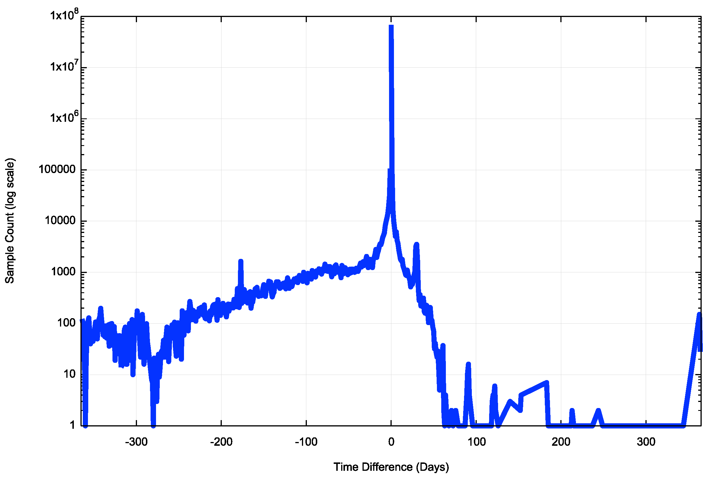
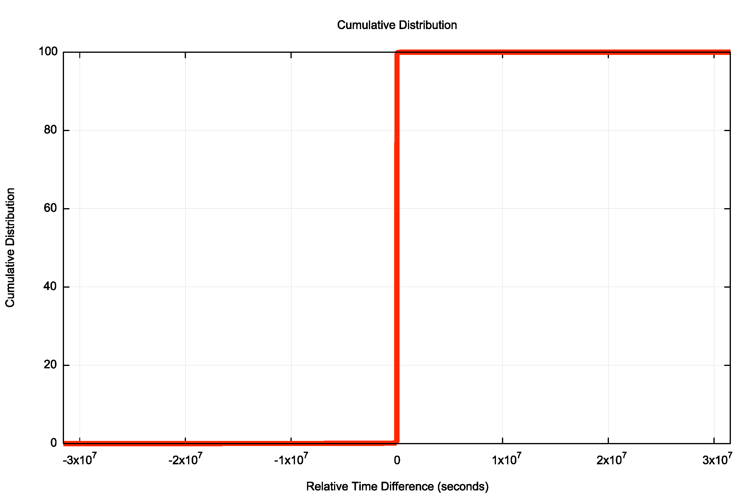
Results
We tested the clock of 202,460,921 clients over a 80 day period:
  11% of clocks are more than 1 second fast
  57% of clients are more than 1 second slow
  We observed clock slew values of up to 1 year both fast and slow
  92% of clients are within 120 seconds of the reference clock

Slide 15
A view of Whole of Internet Time
Only 58% of visible clients run their clock with 2 seconds of UTC time
92% of visible clients run a clock that is within 60 seconds of UTC time
98% of clients are within 1 hour of UTC time

Slide 16
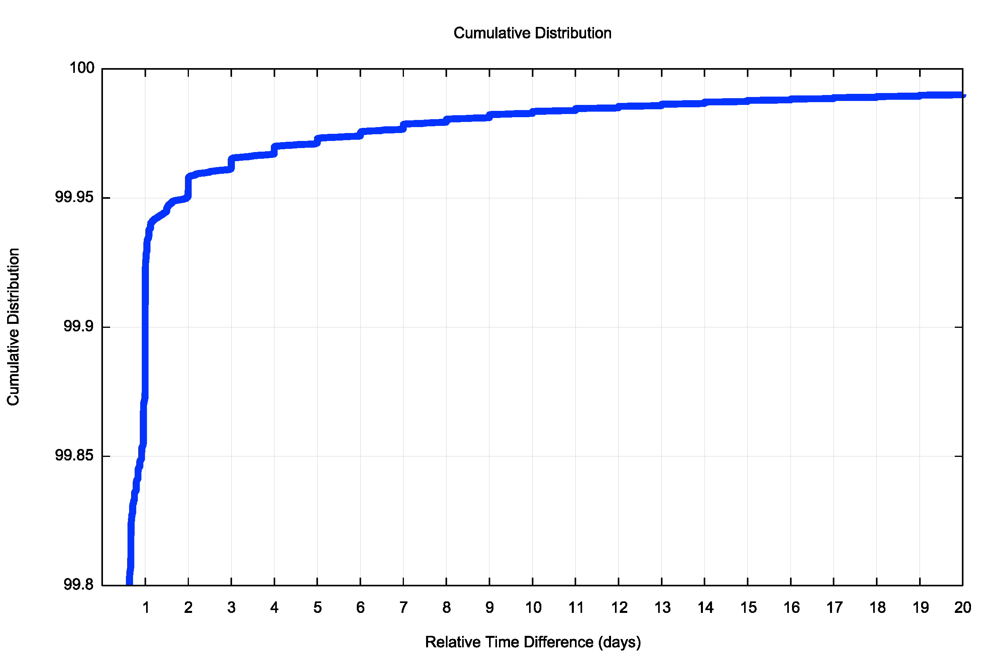
Fast Clocks
0.05% of all clocks are ahead by more than 2 days
There is a clear step function in this distribution that is aligned quite precisely to whole days
How can a client clock maintain a stable per-second clock, yet report a time value that is off by a number of whole days?

Slide 17
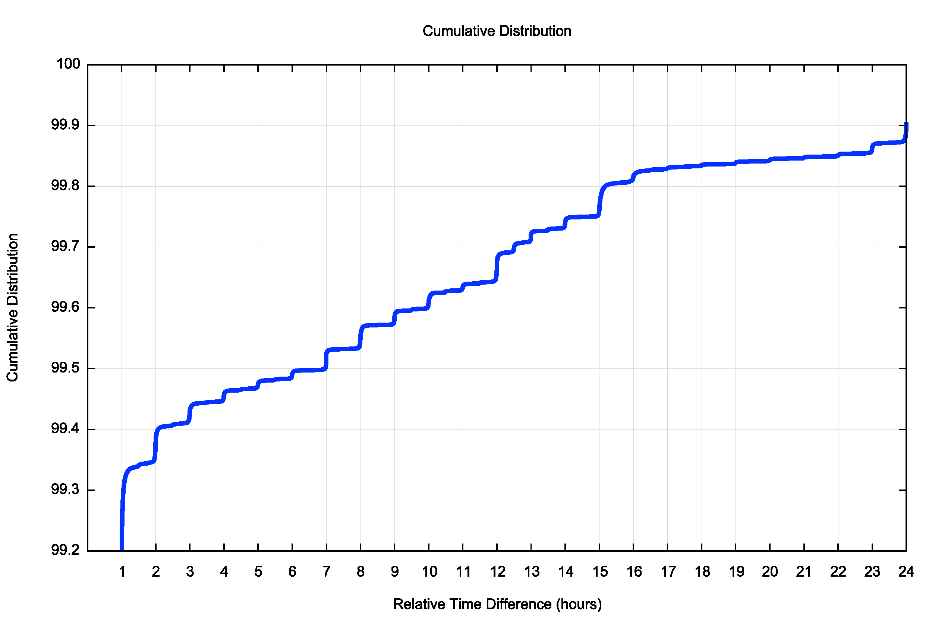
Fast Clocks
0.7% of all clocks are ahead by more than 1 hour
As with the day distribution, there is a marked clustering of the clock offsets into units of hours, and a slightly smaller clustering into half-hours
Similar question: How can a client clock maintain a stable per-second clock, yet report a time value that is off by a number of whole hours?

Slide 18
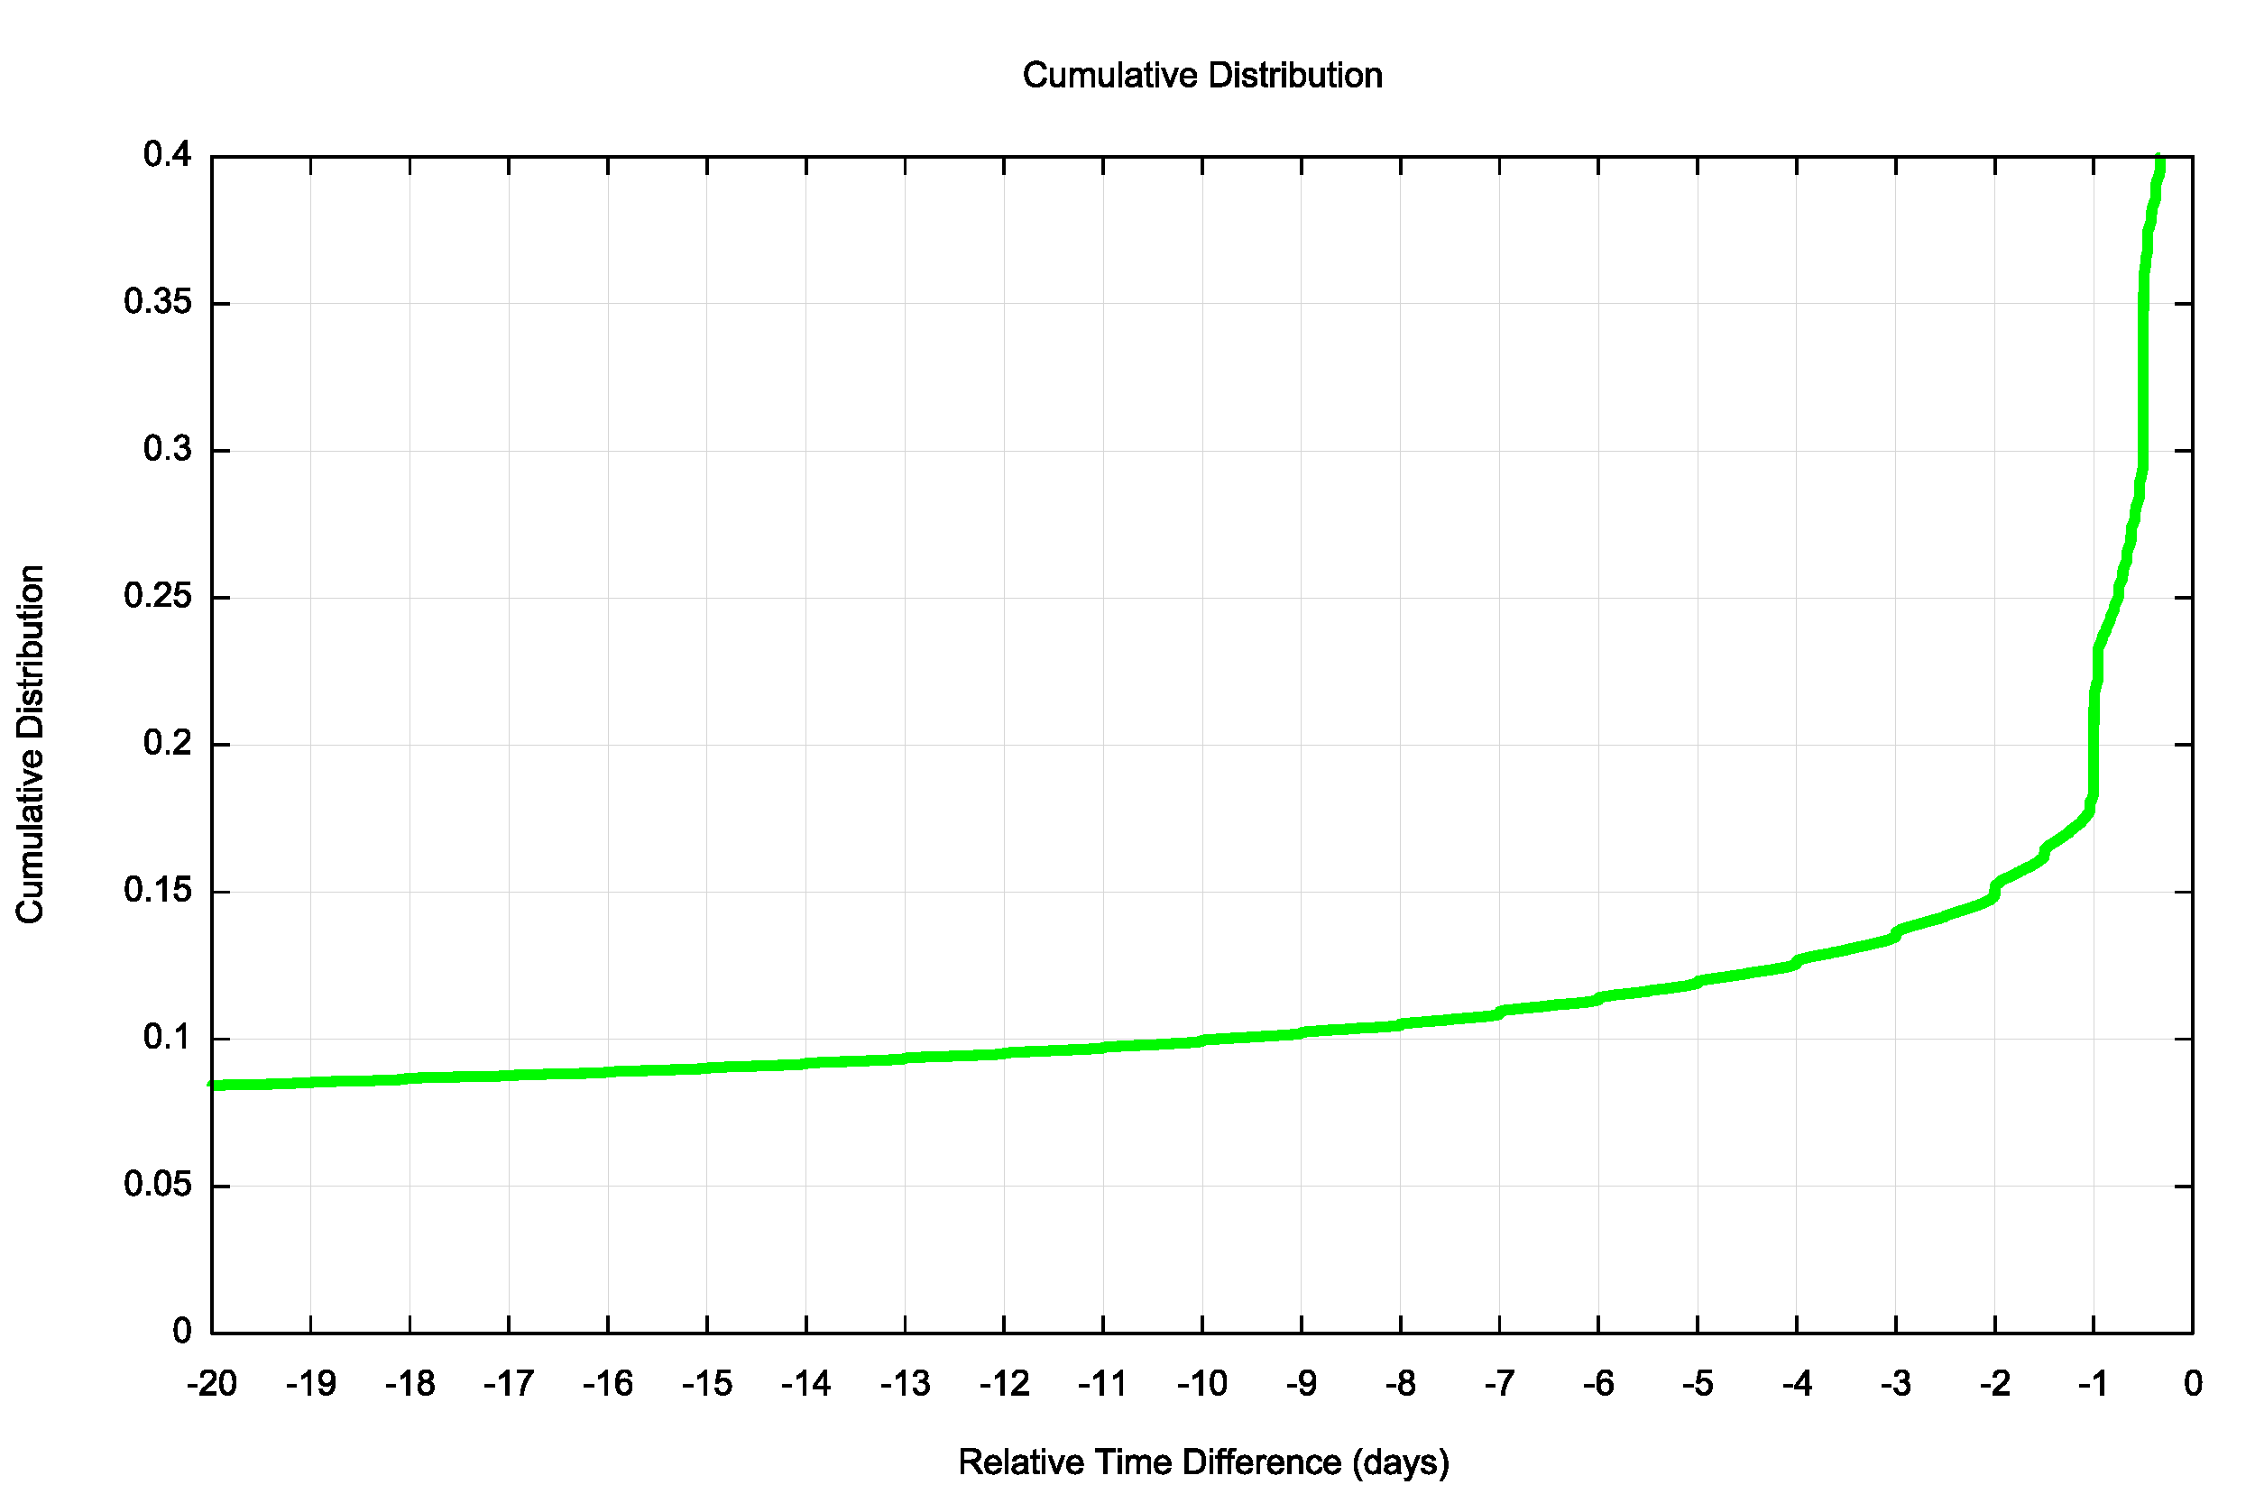
Slow Clocks
0.15% of all clocks lag by more than 2 days (3 x the number of fast clocks)
The per-day clustering is not so clear for slow clocks with a lag of greater than 2 days.

Slide 19
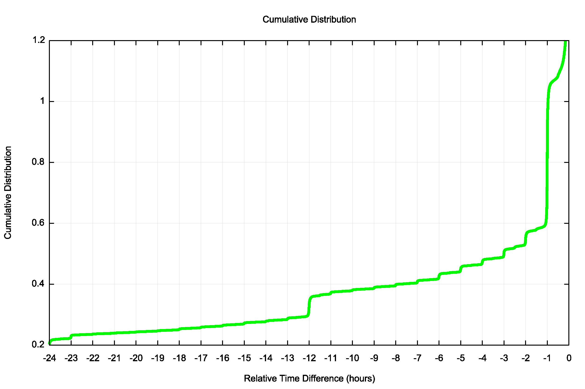
Slow Clocks
1.05% of all clocks lag by 1 hour or more
Here there is a marked clustering of the clock offsets into units of hours

Slide 20
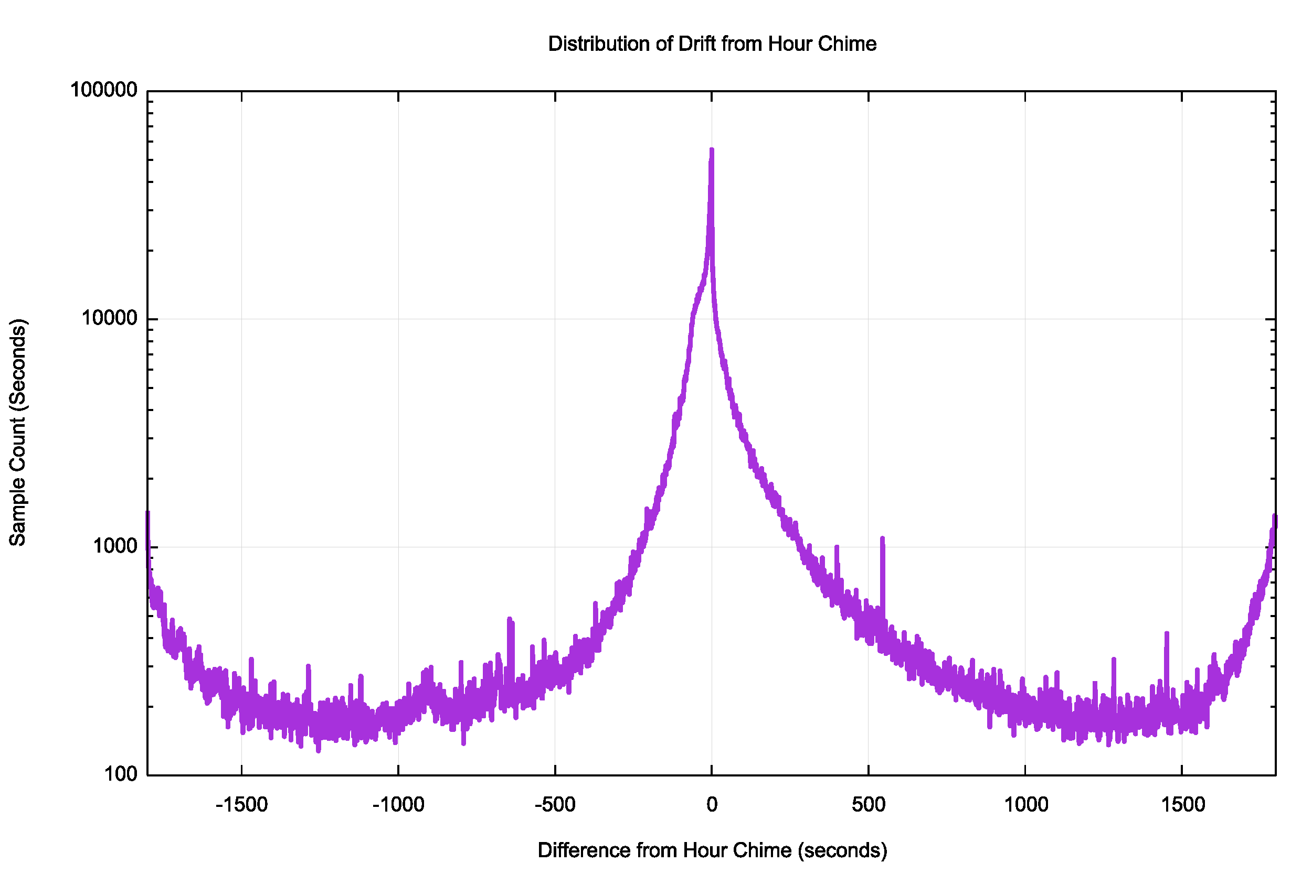
Clustering of Clock Slew Values
This is a distribution of the clock slew values when the whole hours are removed
There is a very strong signal that when a clock has slewed from UTC time it does so in units of hours (and less so in units of half-hours)
NTP does not stablilze a local clock into a slew value of a whole number of hours, so this distribution is not an artefact of NTP.
What is going on here?

Slide 21
Clustering of Clock Slew Values
This is a distribution of the clock slew values when the whole hours are removed
There is a very strong signal that when a clock has slewed from UTC time it does so in units of hours (and less so in units of half-hours)
NTP does not stablilze a local clock into a slew value of a whole number of hours, so this distribution is not an artefact of NTP.
What is going on here?
Does anyone here have some idea of what causes this?

Slide 22
Thanks!

